Slide 1

Back in black

Slide 2
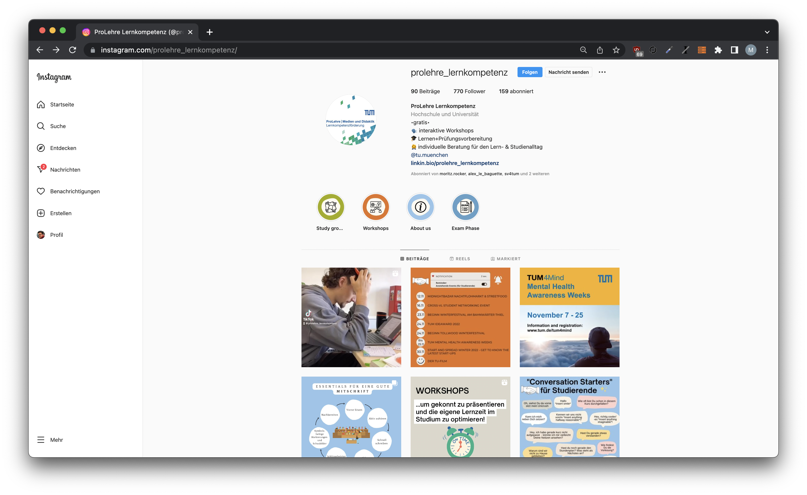
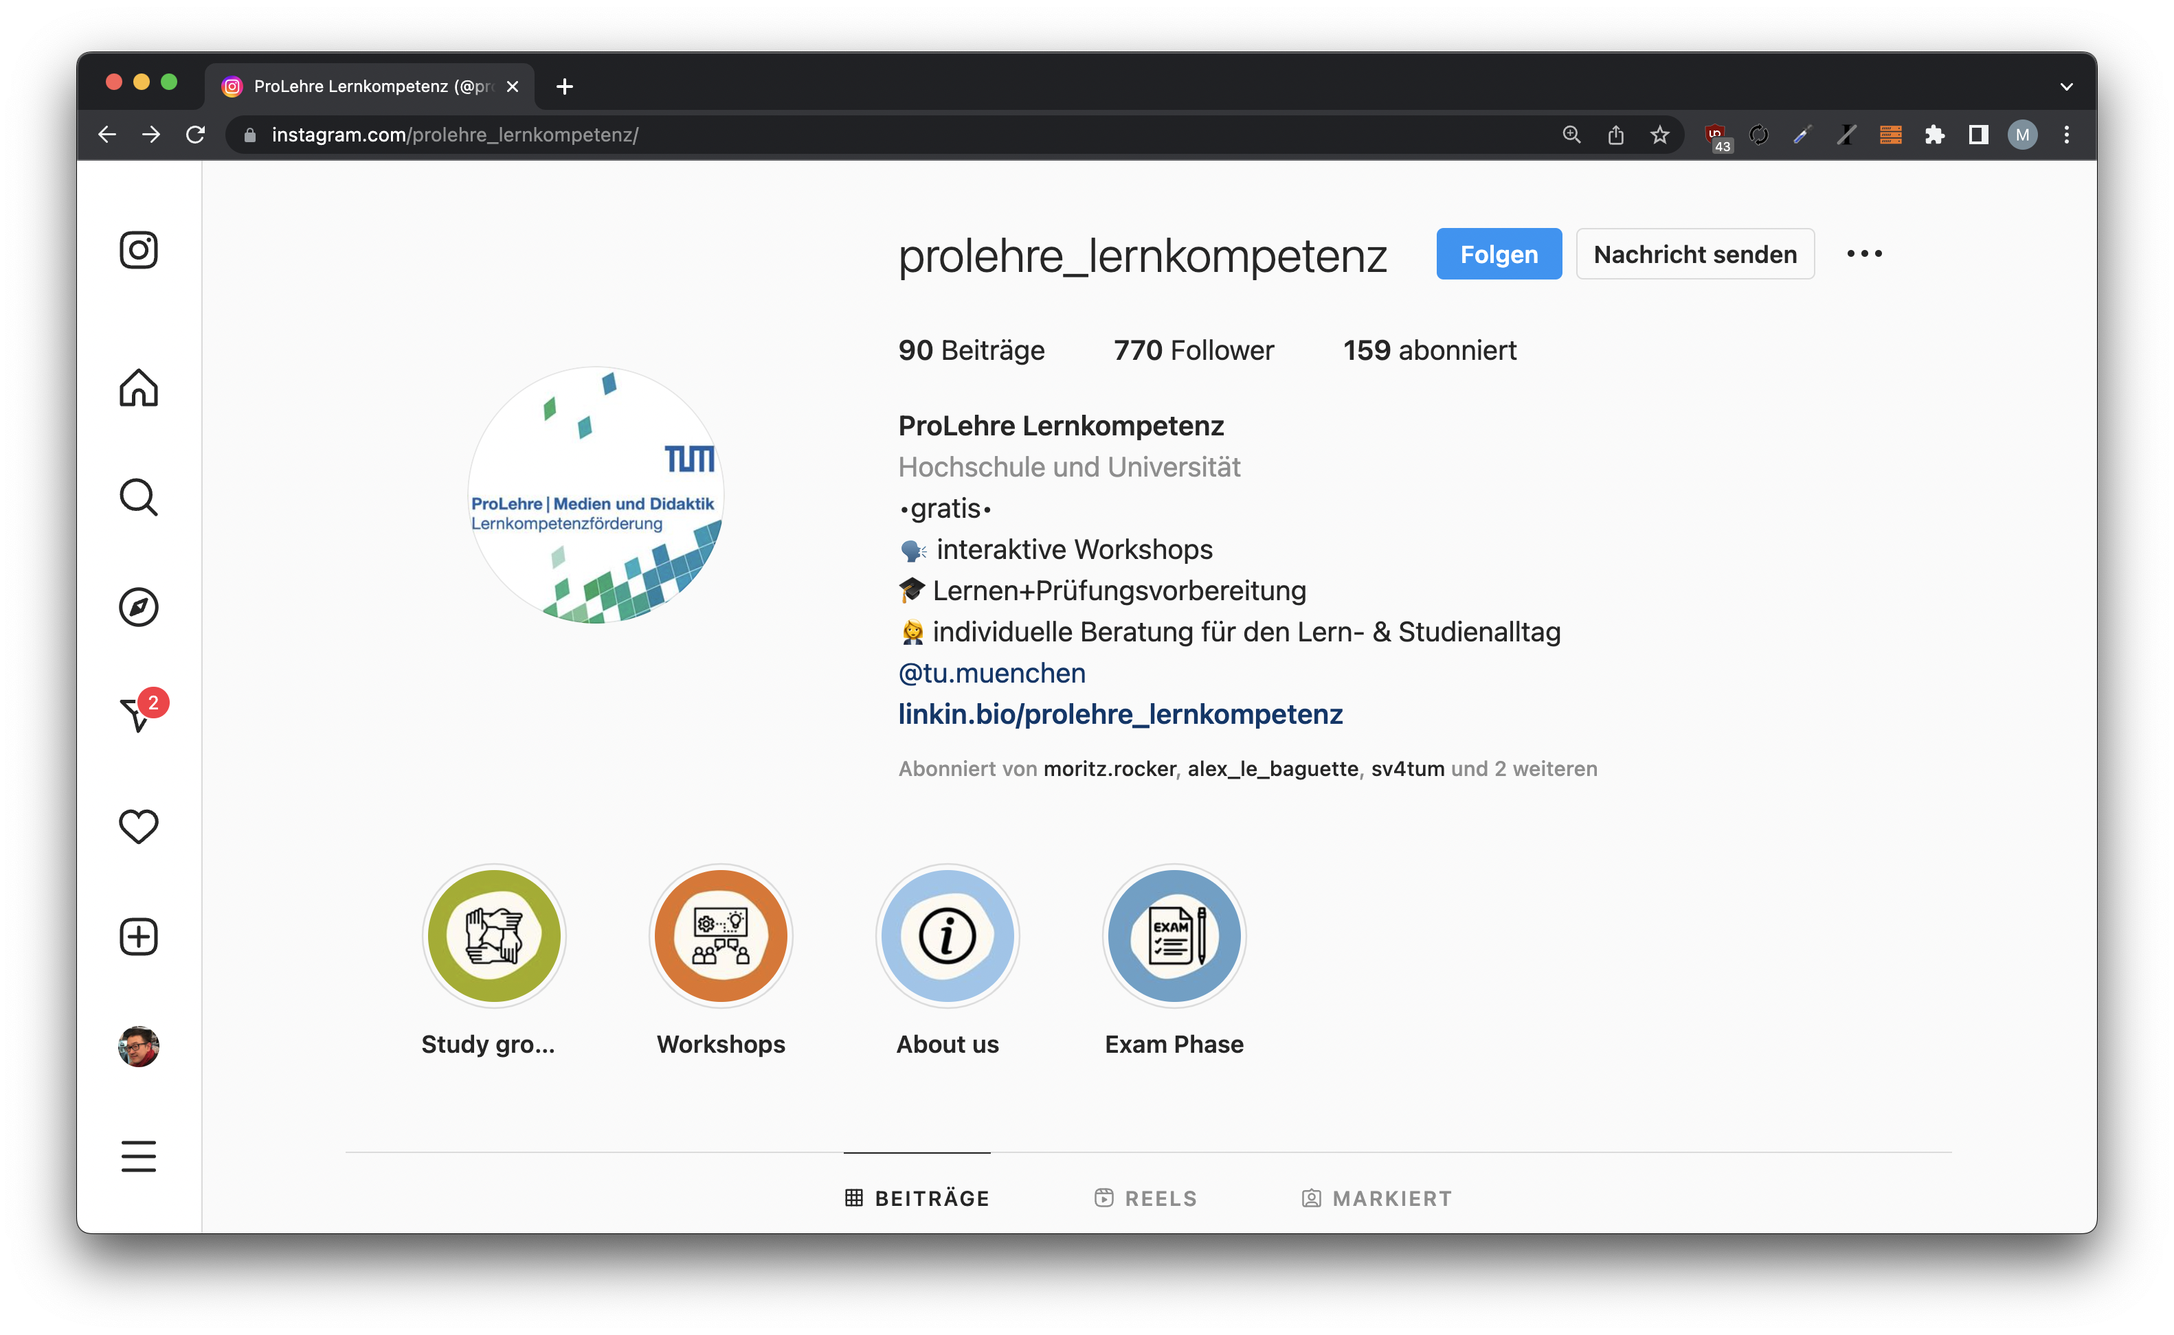
Back in black

Slide 3
Back in black

Slide 4
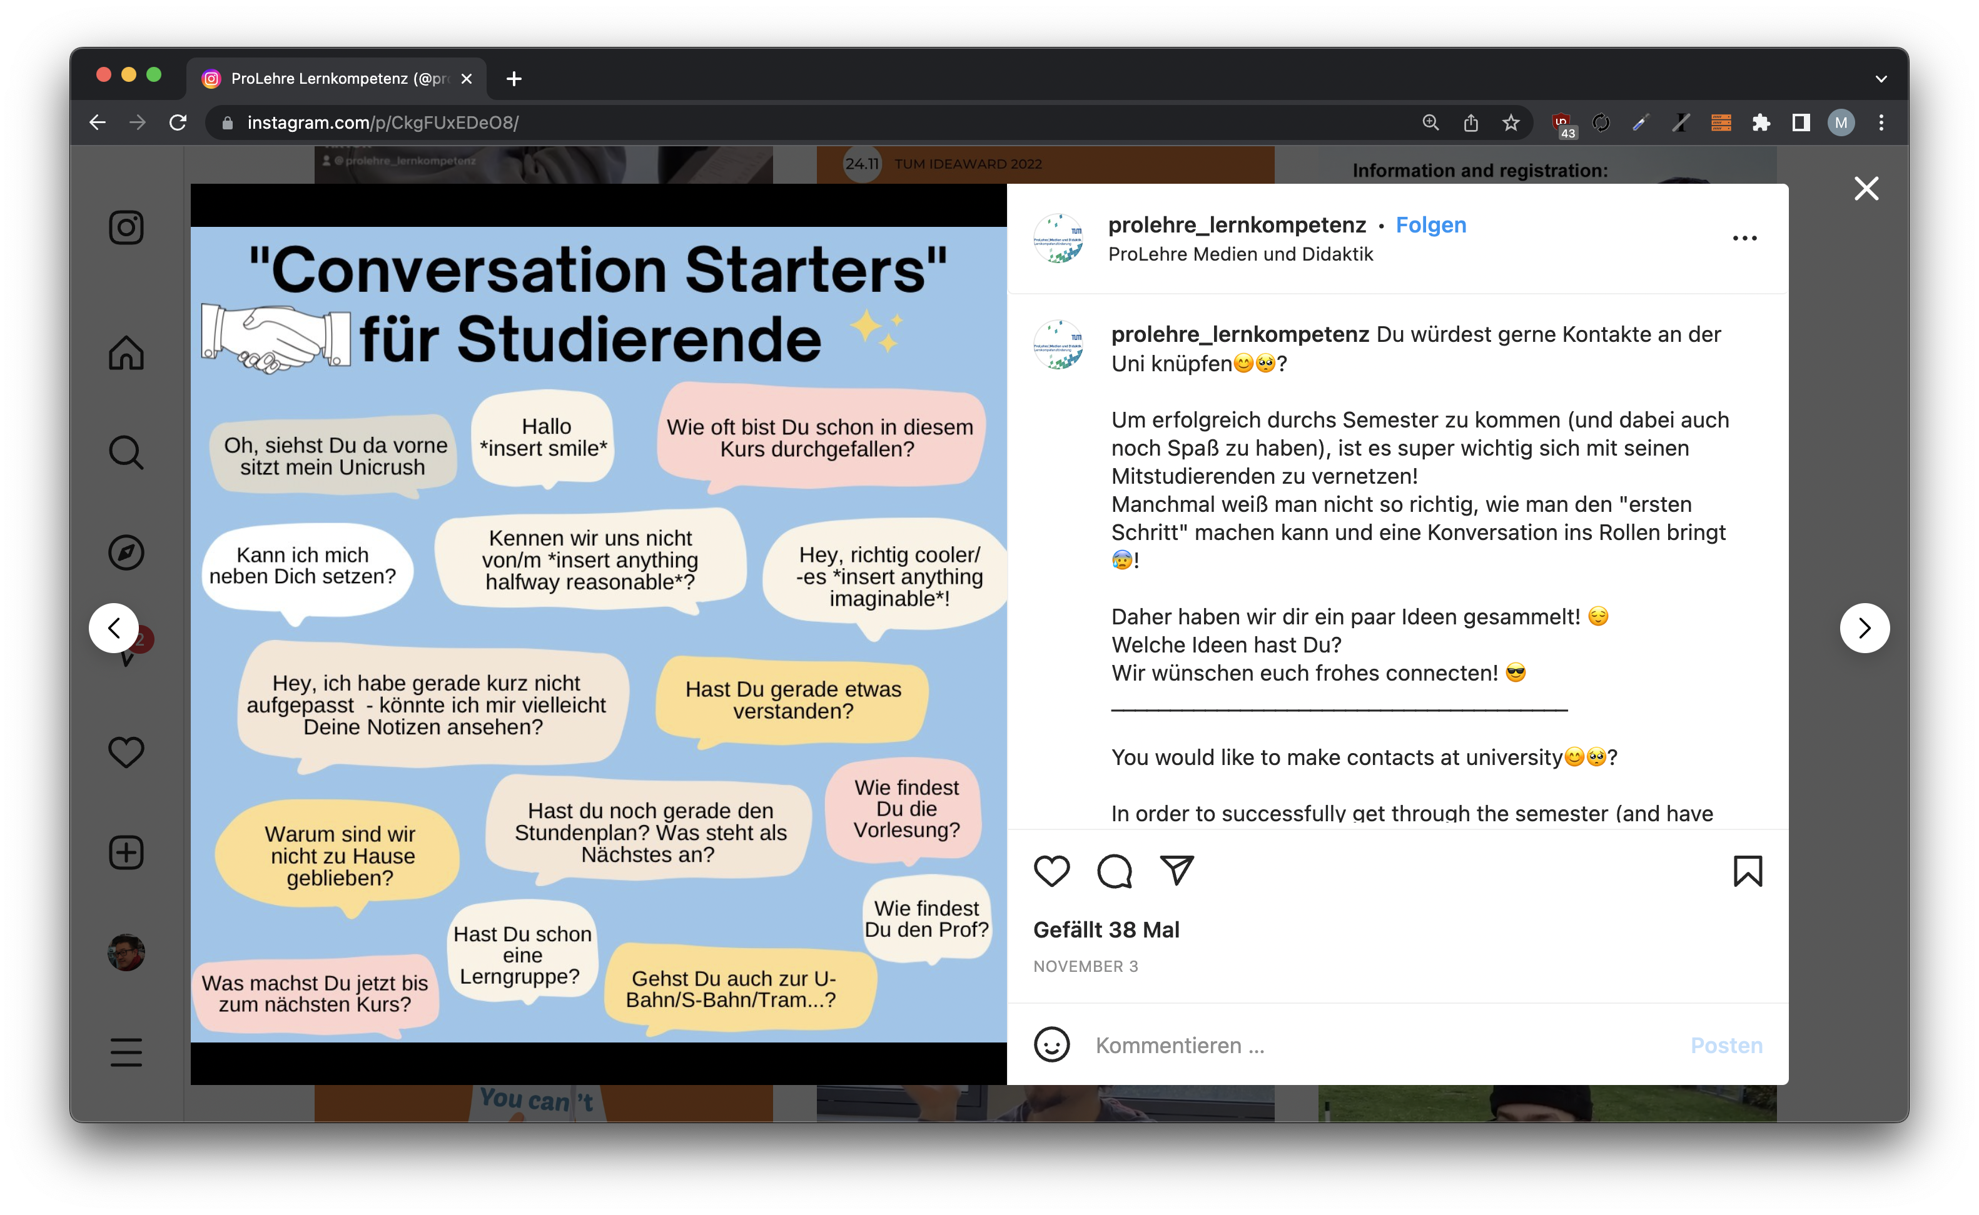

Back in black

Slide 5
Back in black

Slide 6
Back in black

Slide 7
Back in black

Slide 8
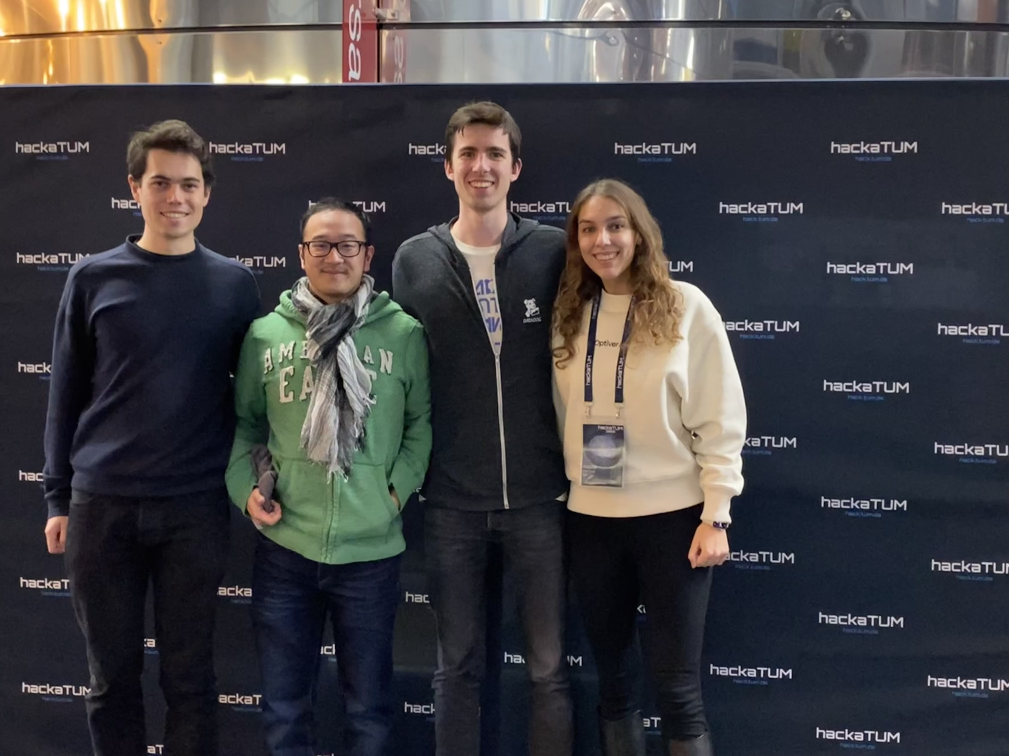

Slide 9
Alex

Slide 10
Fabian

Slide 11
Atessa

Slide 12
Maik

Slide 13


TUMder
Find your learning group
& Mensa buddys

Slide 14
DEMO

Slide 15


What’s next?
apfe
s
TUMonline login with shibboleth
LMU addon

Slide 16
Thank you for your attention!

